Slide 1
Streamlining Lead Service Line Inspections
by
Kip Kritis & Justin Krones
02/21/2023

Slide 2
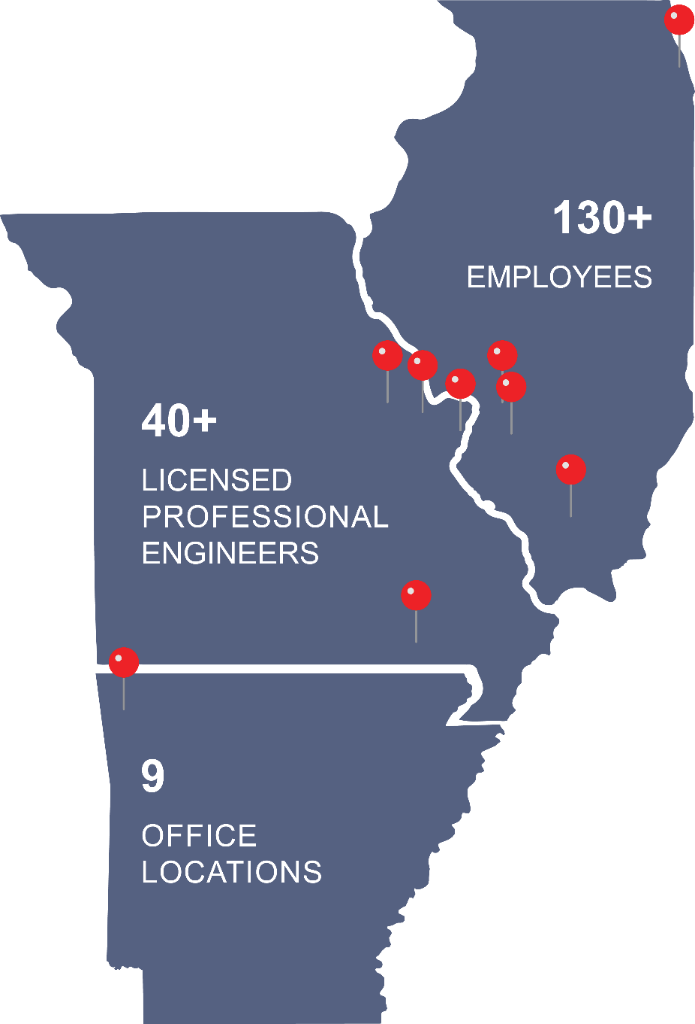
Horner & Shifrin, Inc.
Founded in 1933
Multidisciplinary Engineering Services Firm
3rd largest Engineering Firm in St. Louis (St. Louis Business Journal)
Headquarters in St. Louis, Missouri
Chicago, IL
Marion, IL
O’Fallon, IL
O’Fallon, MO
Poplar Bluff, MO
Bentonville, AR
Notes:
Justin

Slide 3
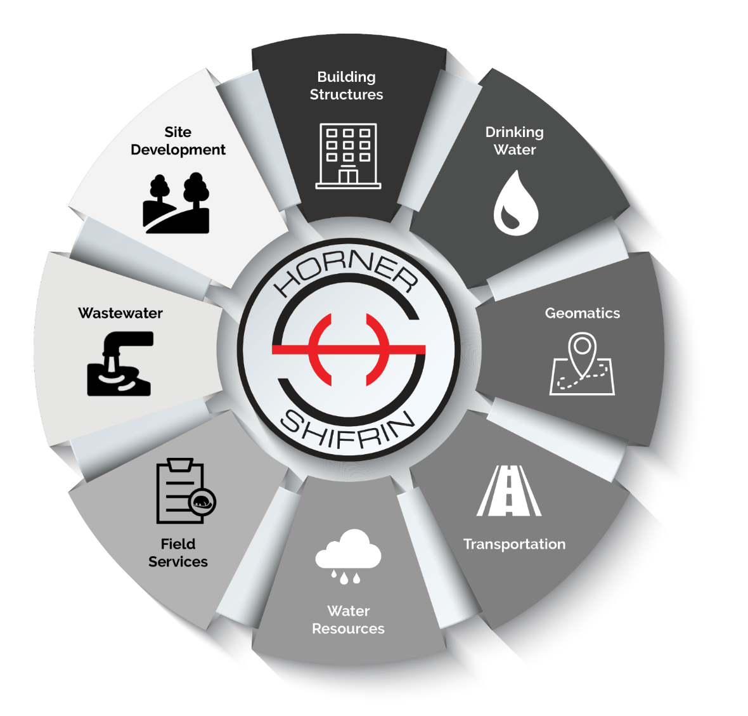
H&S Services Overview
Transportation Roads & Bridges
Site Development
Building Systems & Structures
Geomatics
Drinking Water
Wastewater
Water Resources
Field Services
Notes:
Except Architecture, Geotech, Materials Testing

Slide 4
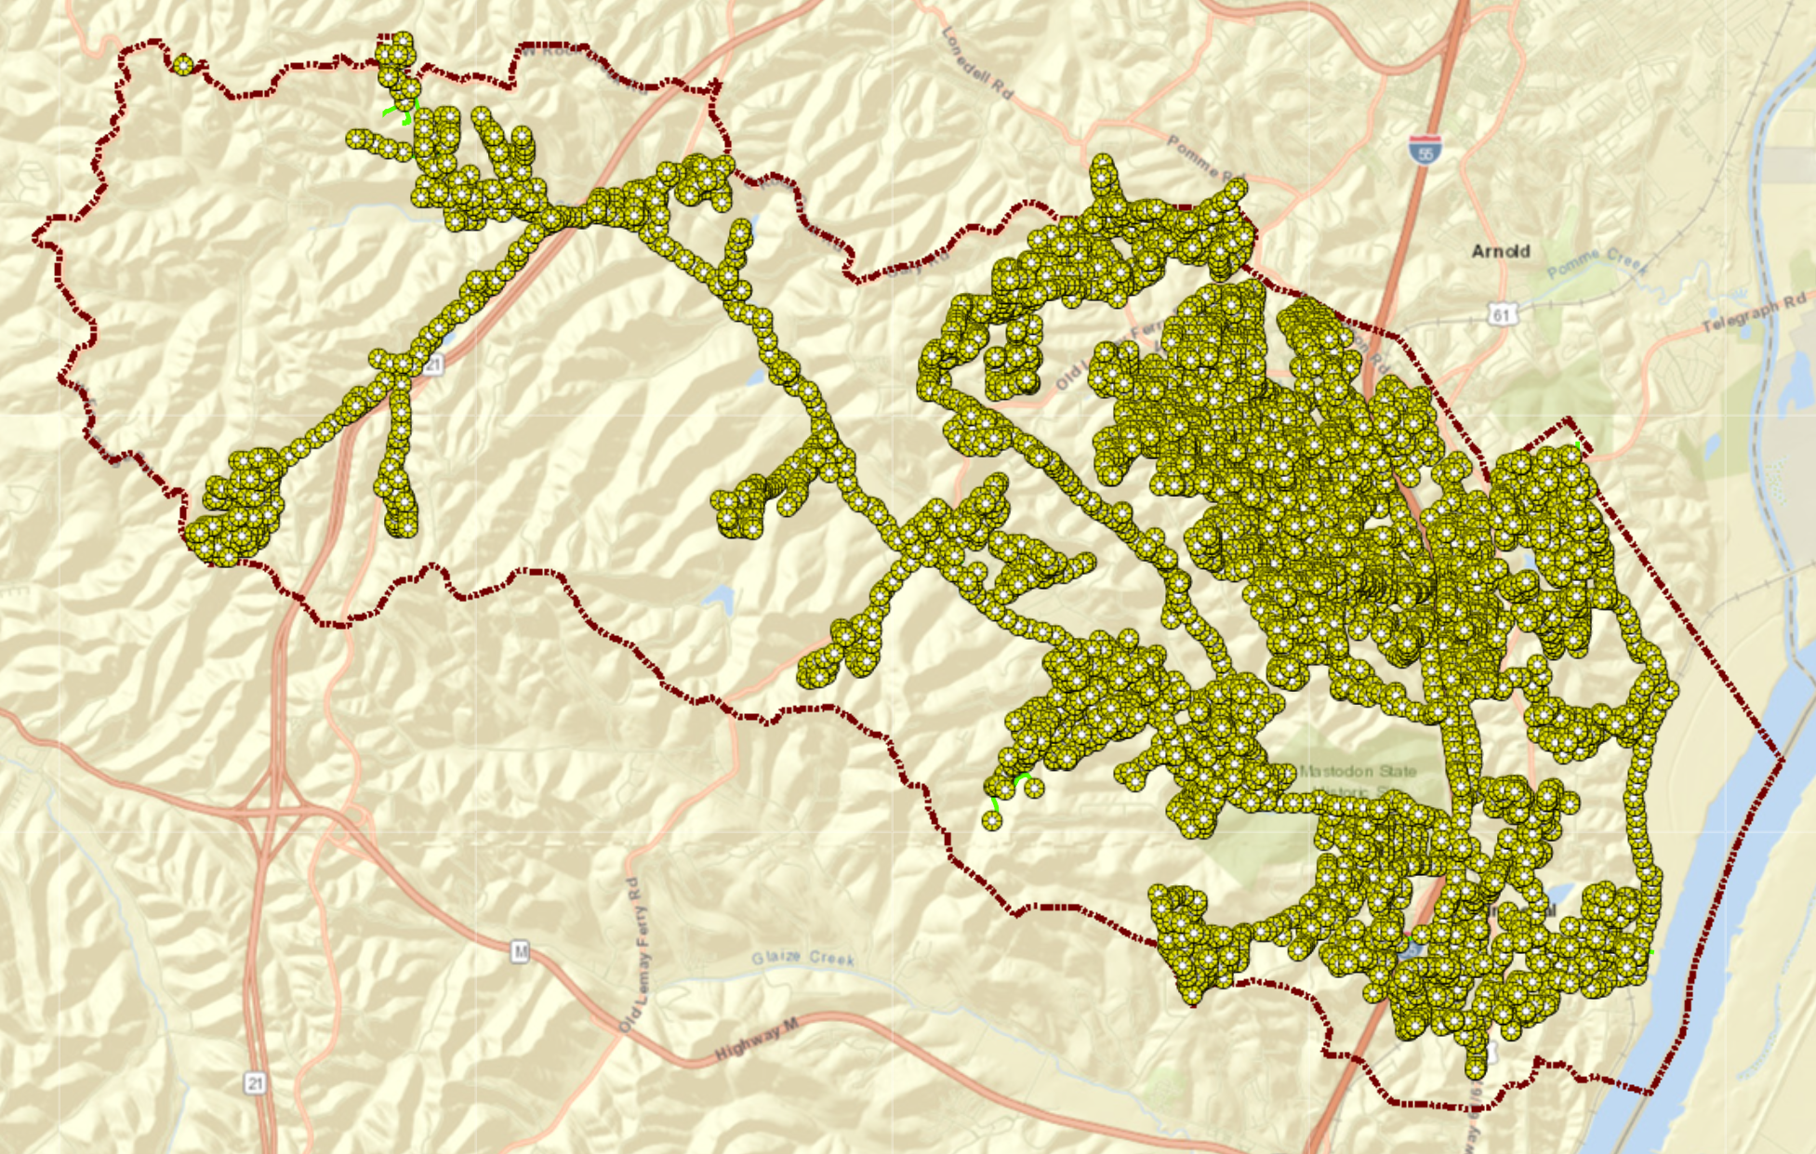
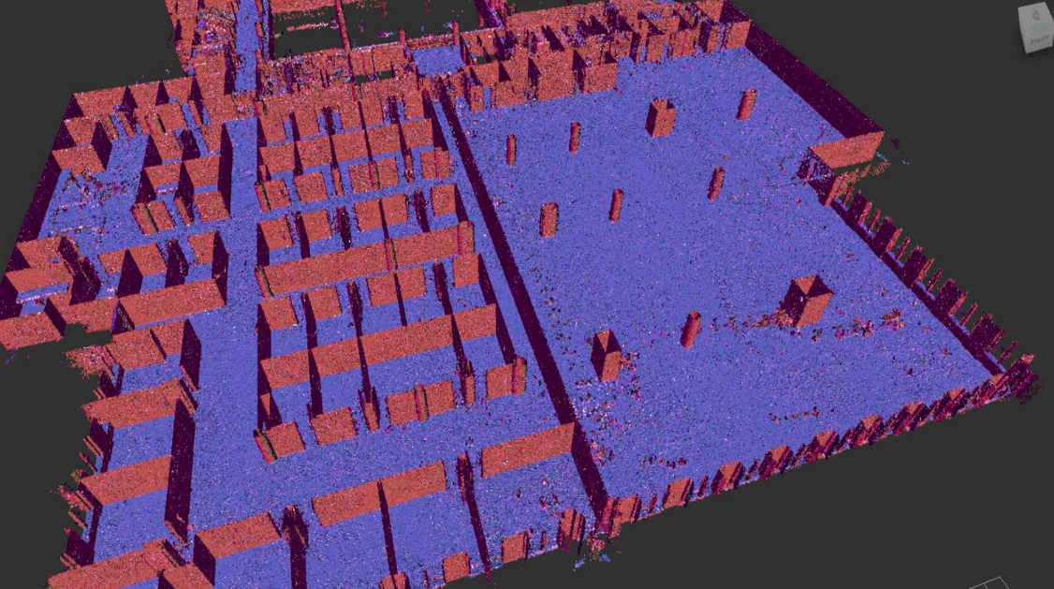
Geomatics
Engineering Support
CAD to GIS (vice versa)
Data Integration
GIS Solutions
Client support
GIS Hosting / Mapping
Asset Management
Boundary & Topo Surveying / Inspections
Aerial Drone LiDAR / Photogrammetry
3D Static and Mobile Scanning
Notes:
Engineering Support
- CAD to GIS
- GIS to CAD
- Data Integration/hosting/scrubbing
- Recommend GIS Solutions
Client Support
- GIS Hosting/Mapping
- Asset Management
- Data Collection
- Drone Flights
- 3D Scanning

Slide 5
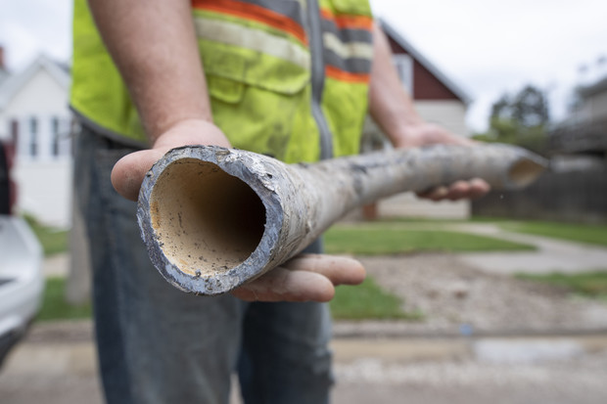
What is a Lead Service Line?
All or portion of service line composed of lead
Excludes lead connectors (goosenecks, pigtails, etc.)
Connects water main to customer’s property
Responsibility
Customer vs. City / District
Notes:
It is the service line that connects from the water main directly to the customer’s house
Service line starts at the customers home and ends at the customers property line and as terms Private or Customer Side
Water line that continues past the property line and into the water main is known as the Public side
Responsibility is shared between the city/public and homeowner/private | the split occurs at the property line

Slide 6
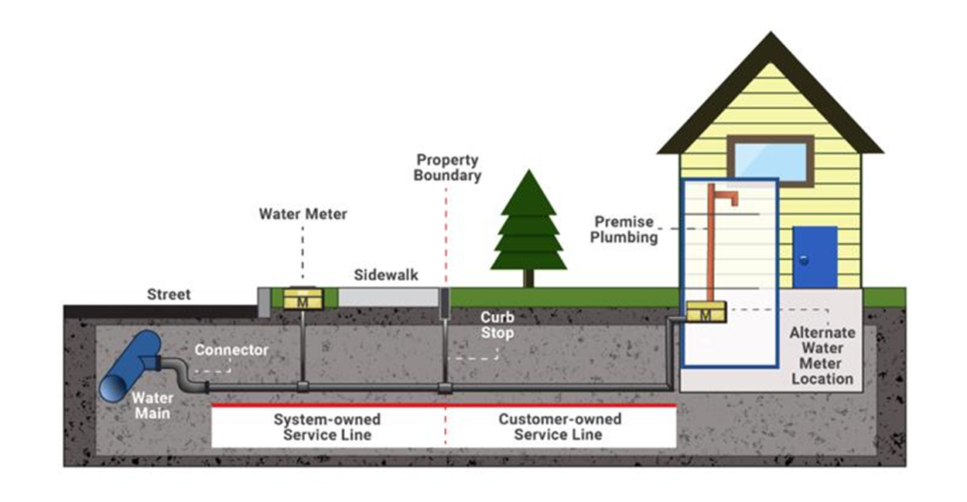
Notes:
*Justin to explain the diagram
Meter inside or outside customer home
Curb Stop at property line

Slide 7
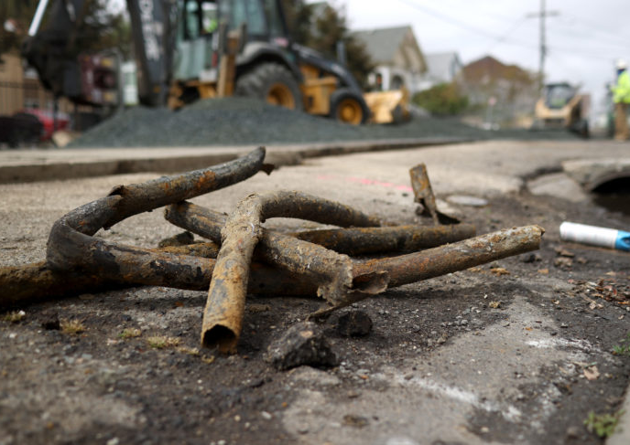
Why Remove Lead Service Lines?
Unpredictably release lead into drinking water
Toxic metal (poisoning dates to ancient Rome)
Harmful to brains especially in children
Between 6 to 10 million lead pipes in the U.S.
Notes:
Lead is well suited for making pipes because it’s stable and easily malleable
Toxic metal (poisoning dates back to ancient Rome)
2015, approximately 99,000 residents of the City of Flint, MI exposed to lead in their drinking water

Slide 8
Lead Service Line History
Pre-1951 Lead as Industry Standard
1991-1992 Lead and Copper Rule Established
2014 Effective Date of Revised Federal Lead Content
1986 First Federal Lead Ban
1988
State Enactment Date
2011
Reduction of Lead in Drinking Water Act Passes
Notes:
Pre-1951 lead was the standard
All service lines constructed after 1988 are assumed to be non-lead and don’t need inspection
The Reduction of Lead in Drinking Water Act was enacted on January 4, 2011, to amend Section 1417 of the Safe Drinking Water Act, which covers the use and introduction into commerce of lead pipes, plumbing fittings or fixtures, solder and flux. The Reduction of Lead in Drinking Water Act changes the Safe Drinking Water Act definition of “lead free” and creates exemptions from the lead free requirements for plumbing products not used for drinking water. The Reduction of Lead in Drinking Water Act established a prospective effective date of January 4, 2014.
2014 lead content law takes effect

Slide 9
Lead Service Line Future
2021
Mandate Finalized and Announced
2031 Mandatory Replacement of all Lead
2024 Mandated Inventory Data Submittal to EPA
Notes:
EPA LSLI deadline by Oct 16th, 2024
Mandated data required for submittal
Deadline is required for the entire Country
Deadline is only 2 years away with specific mandated data requirements for submittal
Replacement of all lead by 2031
WHY?
Unpredictably release lead into drinking water

Slide 10
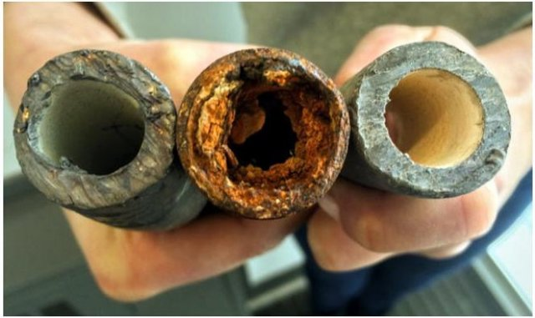
Goals of the LSLI
Document basic system information
Document methods and resources used to create and maintain inventory
Summarize service line inventory
Ownership
Format
Material classifications
Customization
Provide state with required documentation

Slide 11
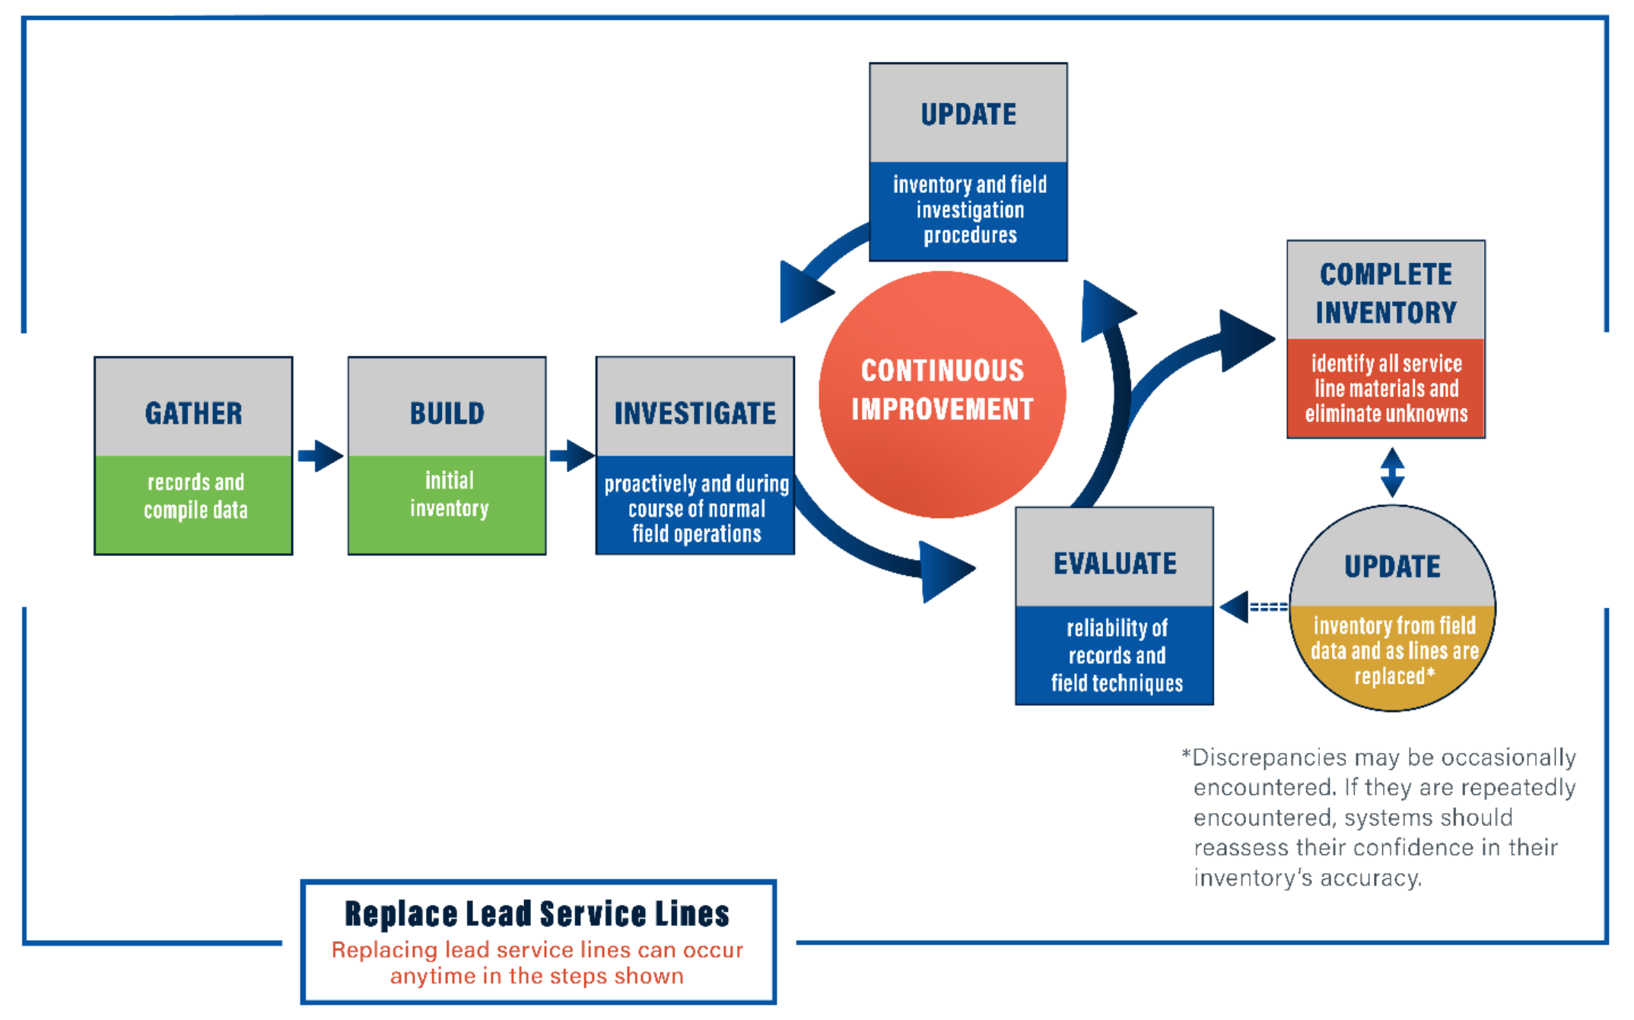
Requirements from EPA
Material Classification
All service lines and ownership
Information to identify material
Submittal deadlines (Oct. 16, 2024) & updates
Public accessibility
Consumer Confidence Reports
Service Line Consumer Notifications
Notes:
Material Classification: Classify each service line or portion of the service line where ownership is split as lead, galvanized requiring replacement, non-lead, or lead status unknown.
Service Line Ownership: Prepare an inventory that includes the system- and customer-owned portions of all service lines in the distribution system.
Identify material: Use previous materials evaluation, construction and plumbing codes/records, water system records, distribution system inspections and records, information obtained through normal operations, and state specified information.
Updates: Annually or Triennially based on water sampling frequency. Water systems that have demonstrated the absence of LSLs by October 16, 2024 are not required to provide an update. However, if these systems subsequently find any LSL or galvanized requiring replacement service line, they have 30 days to notify the state and prepare an updated inventory on a schedule established by the state.
Public Accessibility: Make the inventory publicly available and include a locational identifier for LSLs and galvanized requiring replacement. Water systems serving more than 50,000 people must provide inventories online.
CCR’s: CWS only. LSL – Communicate to public how to access the inventory information. Non-LSL - Provide a statement there are no LSLs and how to access the service line inventory.
Consumer notifications: must notify persons served by water system at the service connection with an LSL, Galvanized requiring replacement or Lead status unknown. Must be able to accommodate for different languages. Notification must be 30 days after inventory was completed. Content must include material information, lead health effects, and ways to minimize exposure.

Slide 12
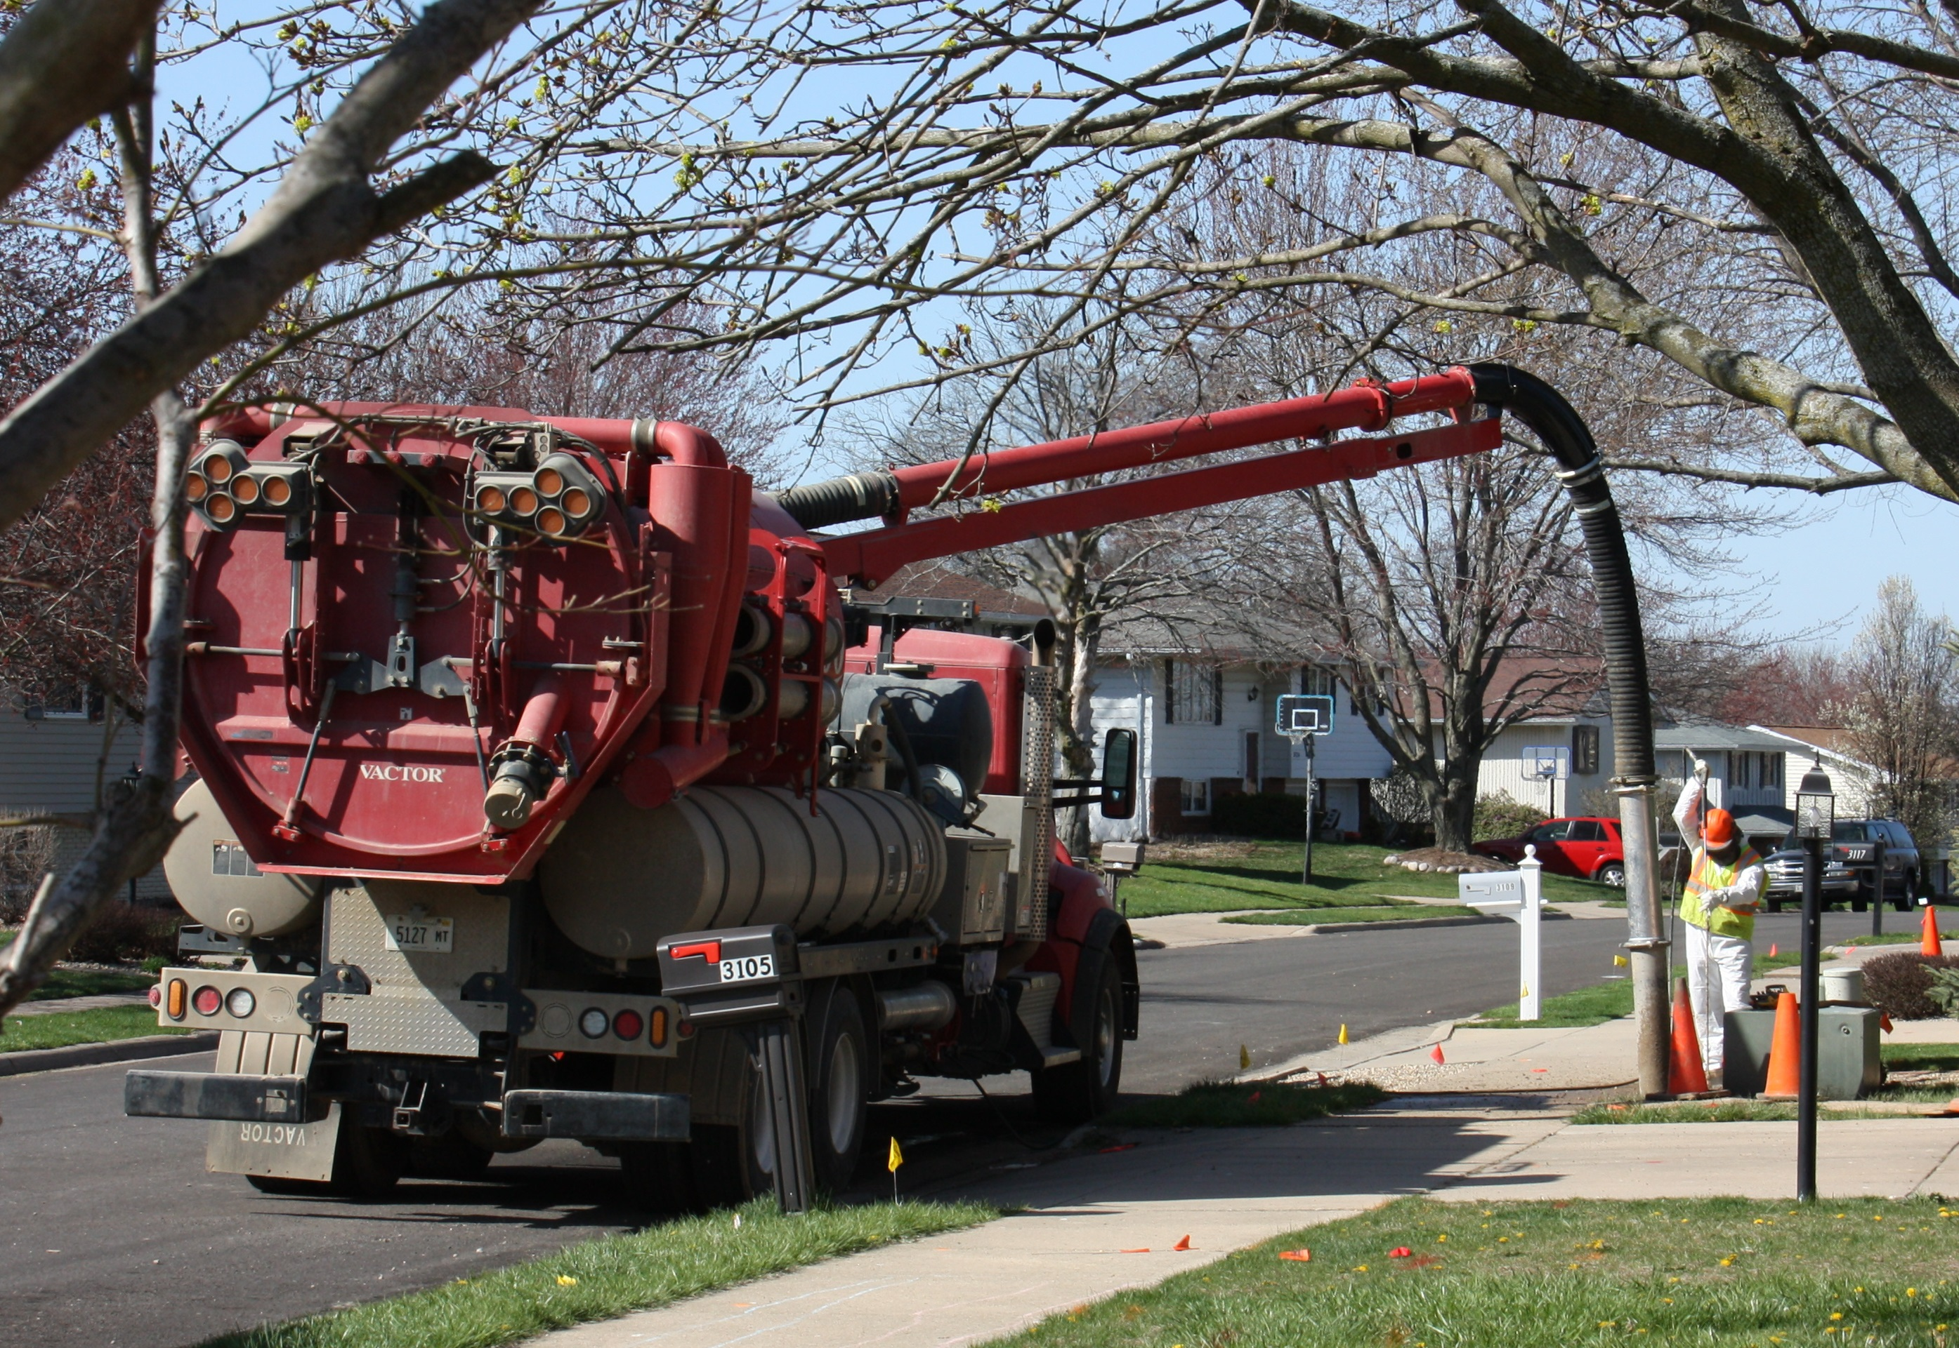
Inventory Process
Inventory to be complete by October 16, 2024
Internal Staff or Use a Consultant
Potholing (Subconsultants who specialize in this)
Residential Reporting of Lead Service Lines
Notes:
Large task at hand to accomplish in 2 years
How it can be accomplished
Can be completed by existing staff or consultant
Potholing or investigative technique used to confirm presence of line and material
Residents can also help by reporting their service line material to the district (example: Waterloo Facebook page)

Slide 13
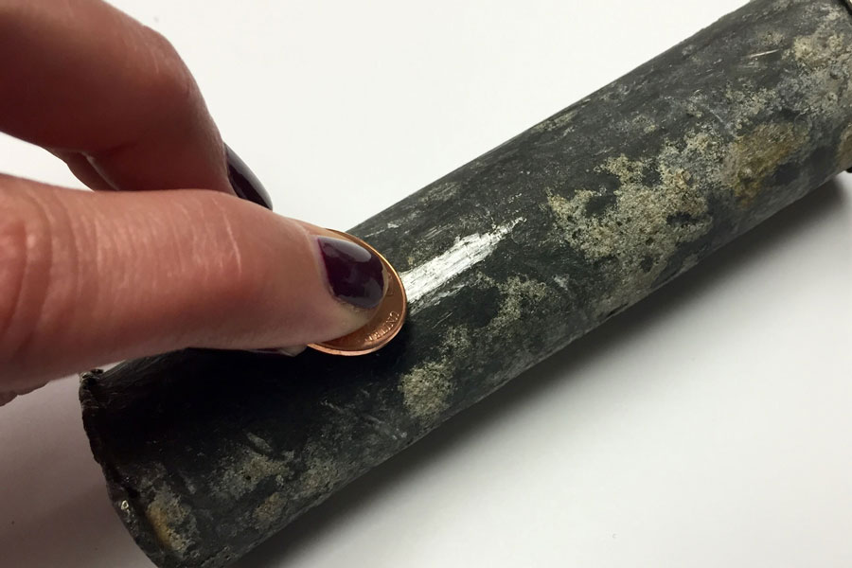
Residential Flyer Example
Notes:
Residents help by testing the service line coming into their house
Scratch the surface of the pipe, magnetic test, tapping test, to determine lead
Send postcard back to district for them to update their system

Slide 14
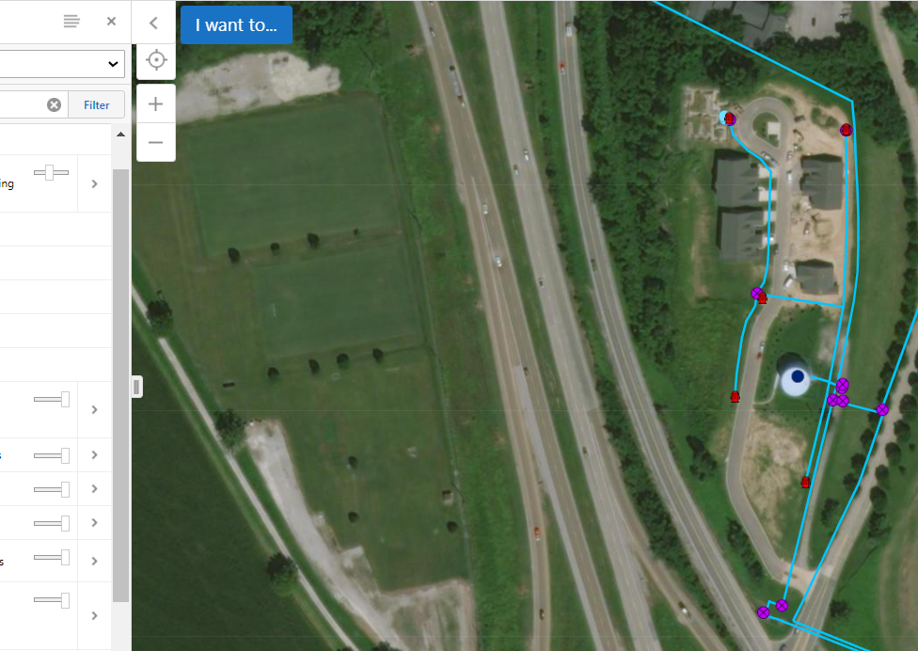
Task at Hand From GIS Standpoint
Setup of GIS
Scalability and Adaptability
Large vs Small Districts
Funding
Notes:
Creating a working system to comply is a time consuming and difficult task
Some districts may want to go beyond the minimum requirements and our template is built to allow for scalability and adaptability
-Inventory water mains
-Water Meters
-Hydrants
Easy to setup for large districts
Hard for small districts with little to no GIS or funding
Who is funding this? Does property owner have to pay for their side to be replaced?
Does the city only fix their lines and then customers side remain lead?

Slide 15
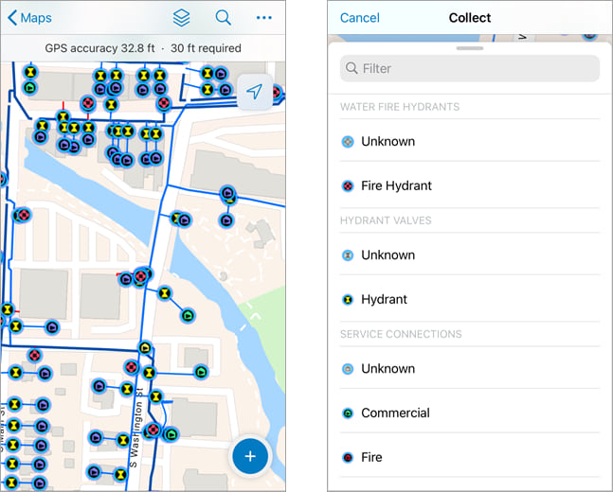
Benefits of GIS
Single database
Realtime updates and changes
Mobility
Offline capabilities
User friendly
Security

Slide 16
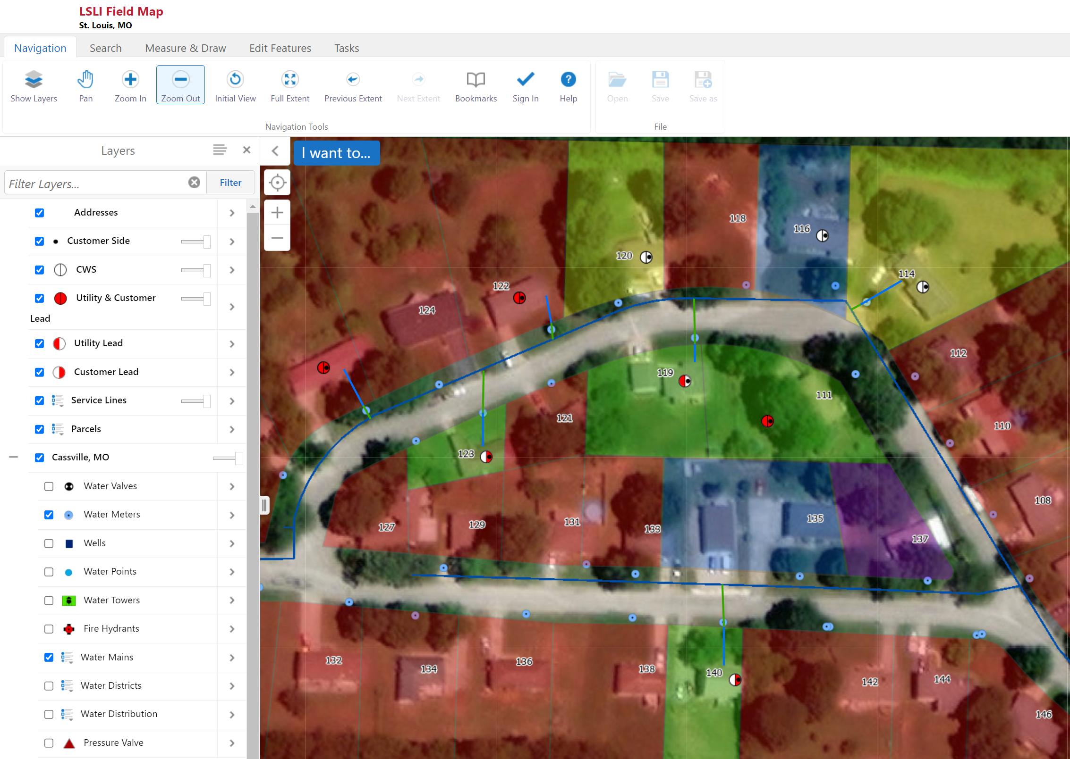
Map Demo
Symbology
Quick look at existing data
Search & Query
Collecting Data

Slide 17
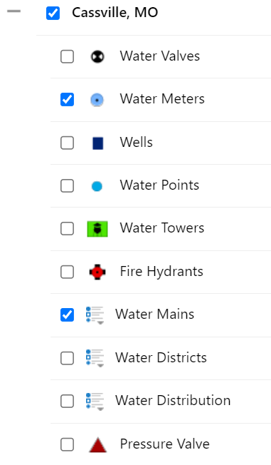
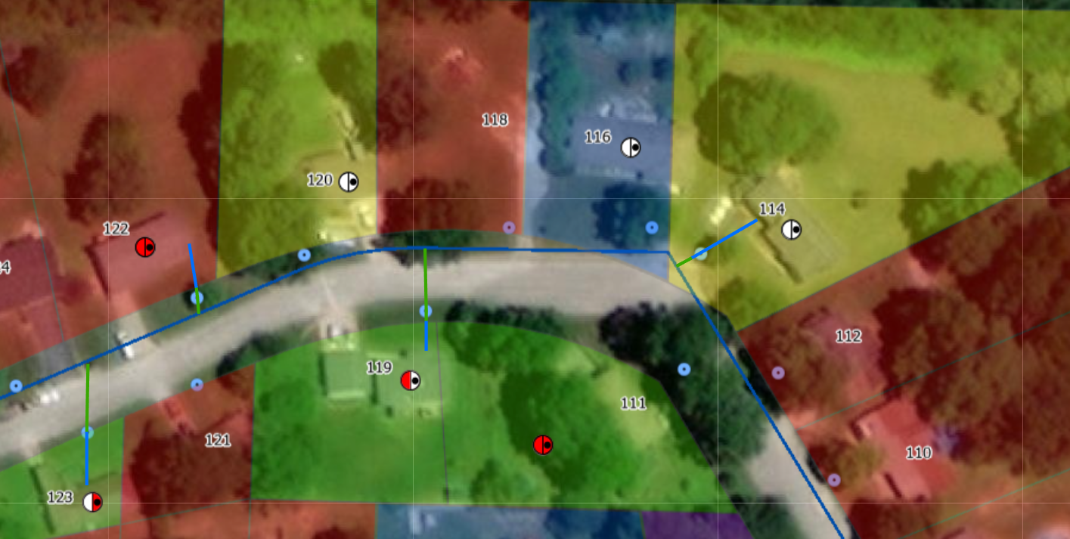
LSLI Symbology

Slide 18
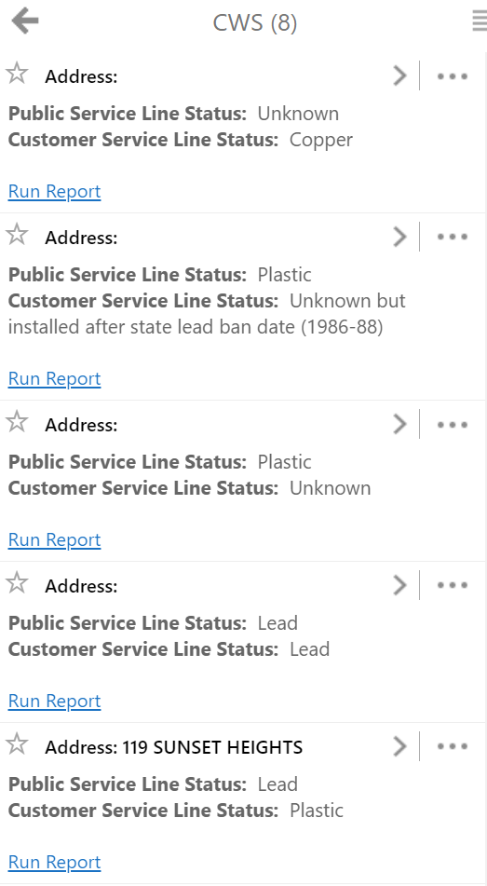
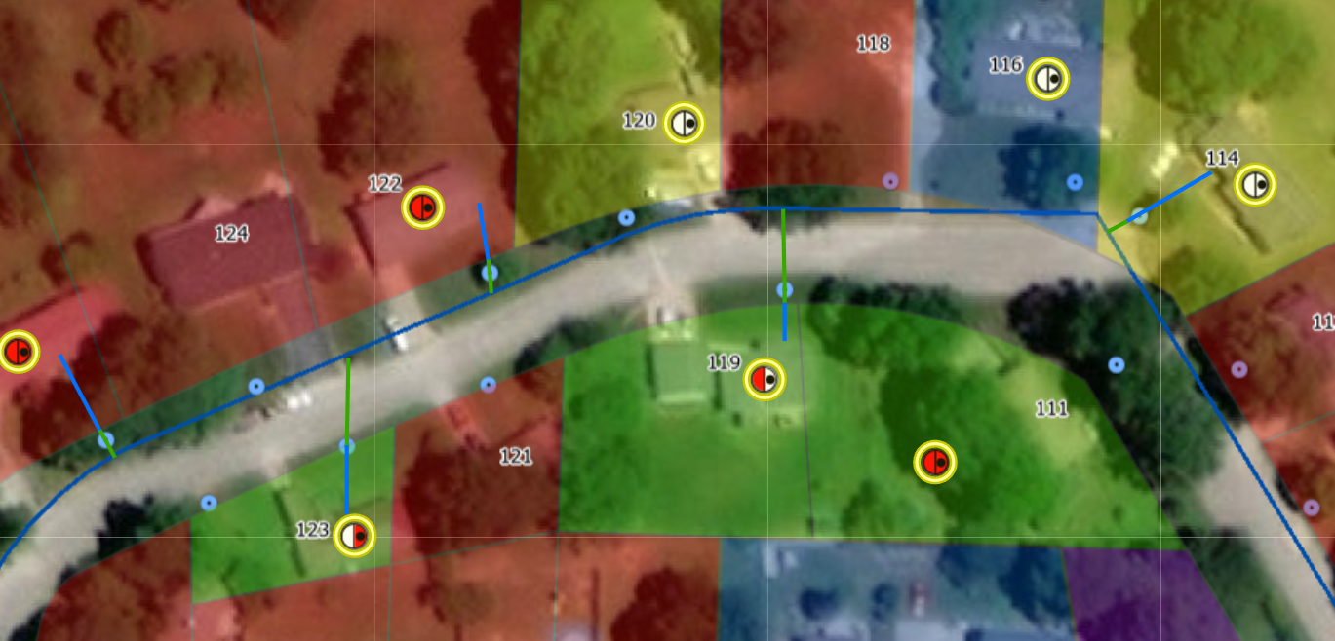
Search

Slide 19
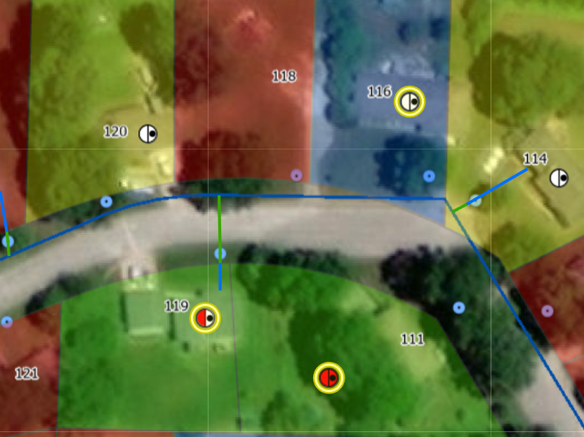
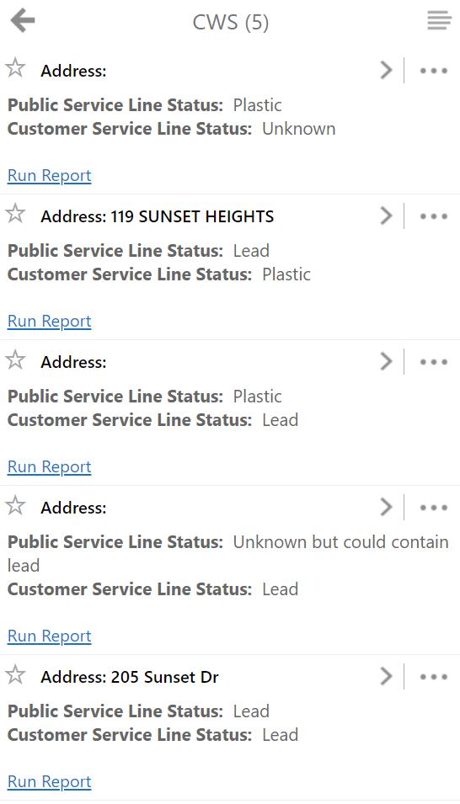
Query

Slide 20
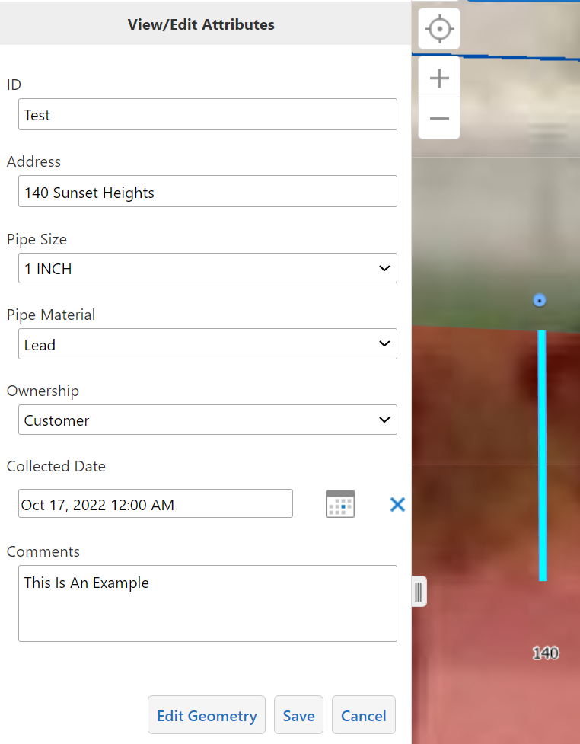
Collecting Data

Slide 21
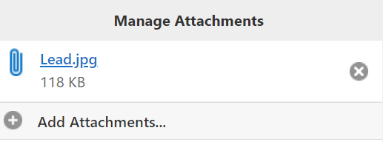
Collecting Data (Cont.)

Slide 22
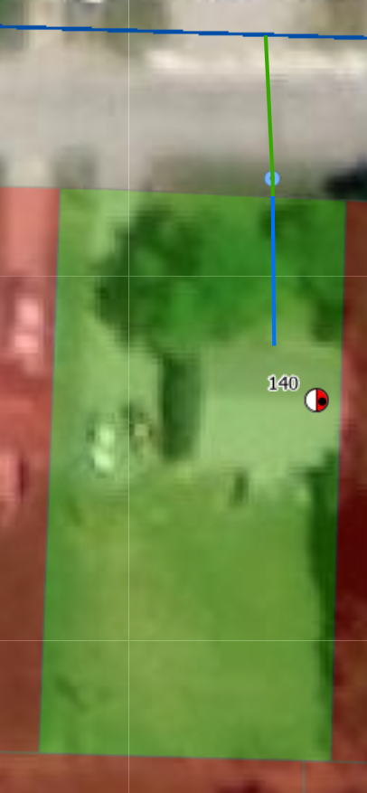
Collecting Data (Cont.)

Slide 23
LSLI Report Types
Summary
Overview
Detailed

Slide 24
LSLI Summary Report
Summary Report
Contains Counts

Slide 25
LSLI Overview Report
Contains all asset information
Allows for a higher viewing of data

Slide 26
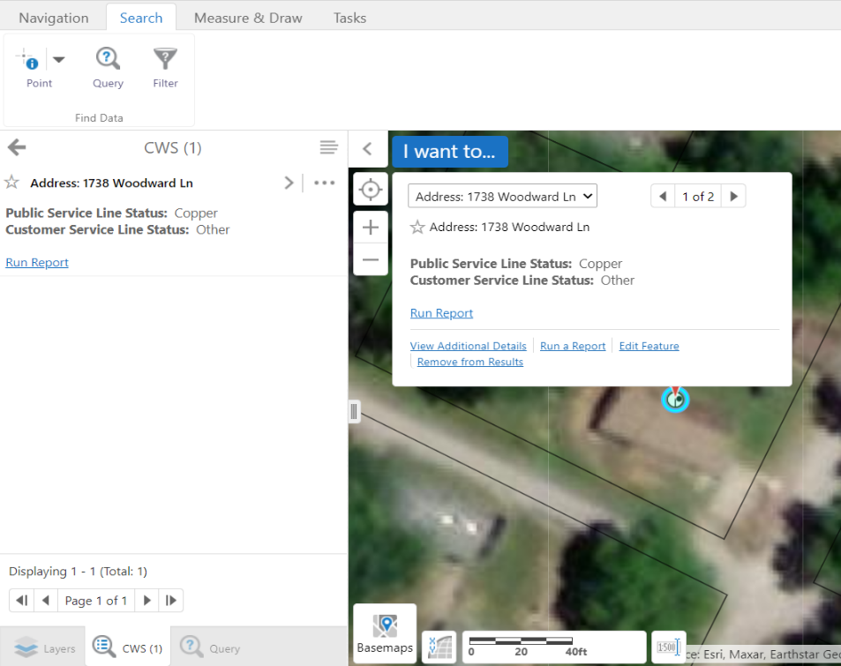
LSLI Detail Report
Detailed Report Purpose
Asset Information
Asset Attachments
Let’s walk through a report!

Slide 27
Questions? Comments! Thoughts.

